Slide 1
Reporting Category 2: Nucleic Acids and Genetics

Slide 2
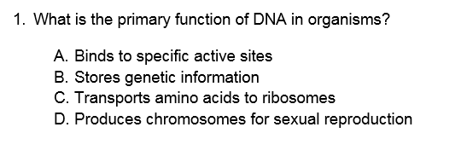
Notes:
6A

Slide 3
Notes:
6A

Slide 4
Notes:
6A

Slide 5
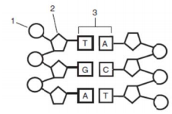
Notes:
6A

Slide 6
Notes:
6A

Slide 7
Notes:
6B

Slide 8
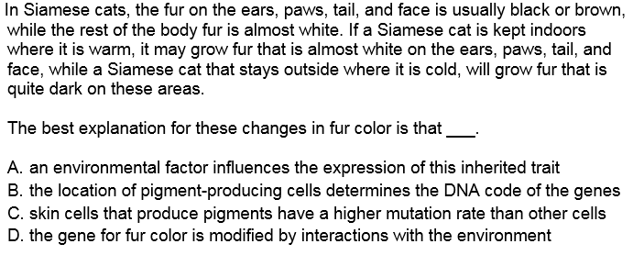
Notes:
6D

Slide 9
Notes:
6D

Slide 10
Notes:
6E

Slide 11
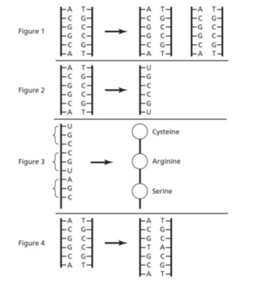
Notes:
6e

Slide 14
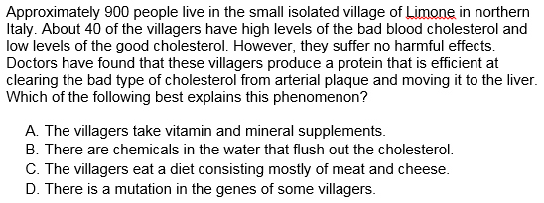
Notes:
6e test taking strategy, read the questions first. Need to read the passage. Look at the information given. No crazy assumptions. What do we know from evolution and genetics

Slide 15
Notes:
6e

Slide 16
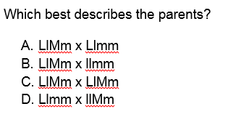
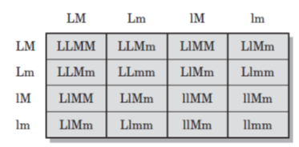
Notes:
6f

Slide 17
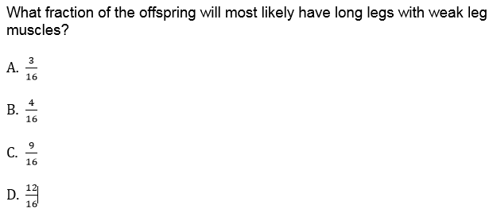
Key:
L = log leg muscles l =short leg muscles
M =strong muscles m =weak leg muscles
Notes:
6f

Slide 18
Notes:
6f – gie other examples, pink, striped ect

Slide 20
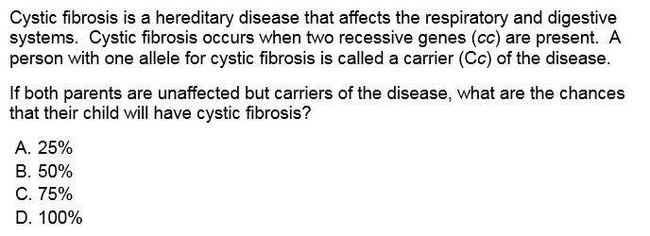

Slide 24
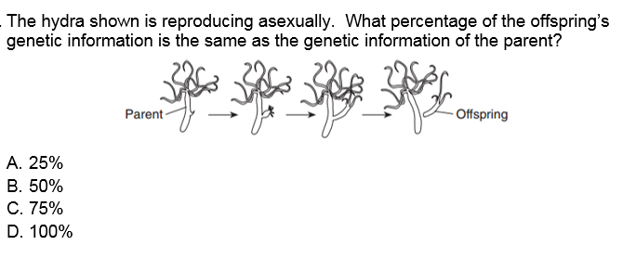
Notes:
6f

Slide 25
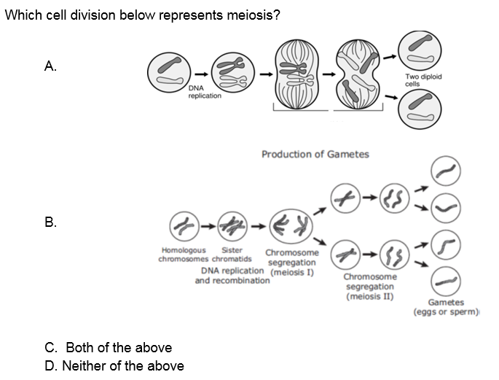
Notes:
6g

Slide 26
Notes:
6g

Slide 27
Notes:
6g

Slide 28
Notes:
6g

Slide 29
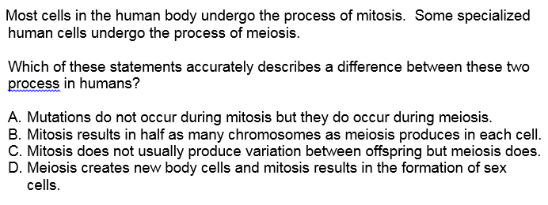

Slide 30
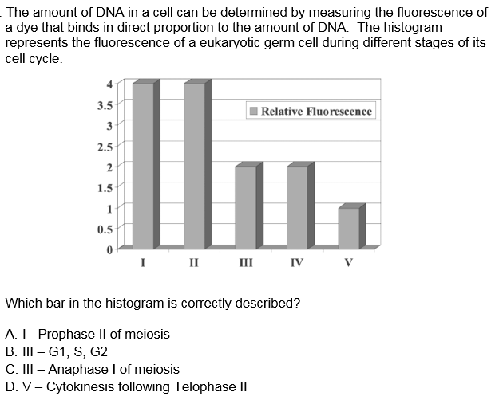
Notes:
6g

Slide 31
fin

