Slide 1
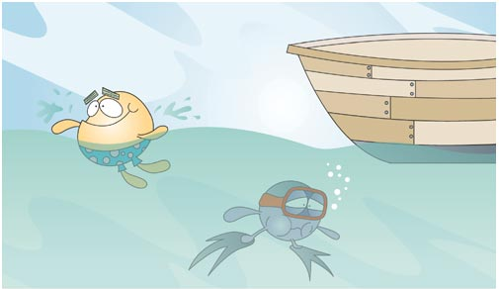

SURFIN’ THROUGH STAAR
Reporting Category 1: Biomolecules and Cells

Slide 2
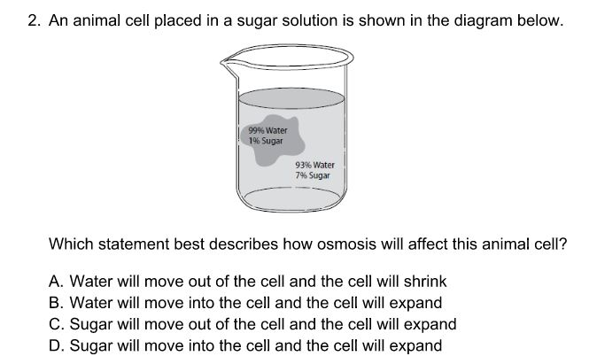

Slide 3
Which diagram represents active transport?

Slide 4
A girl became ill with the German measles and recovered. A year later, she was exposed to the disease again but did not become ill. Which is the most probable explanation for her failure to develop measles after a second exposure?
  Her red blood cell count was elevated.
  The disease virus had mutated to a different strain.
  Specific antibodies were produced as a result of the initial illness.
  Antibiotics taken during the initial illness were still effective.

Slide 5
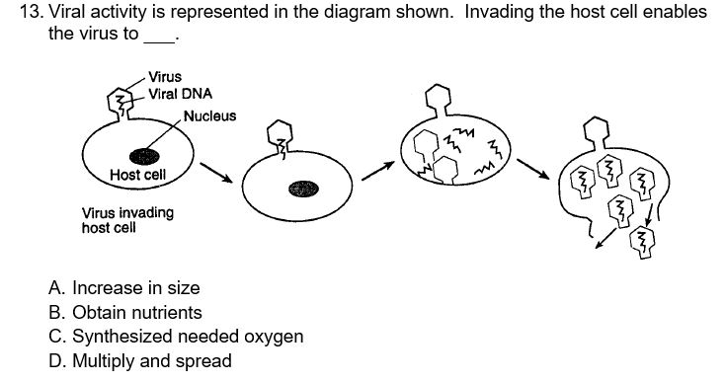

Slide 6
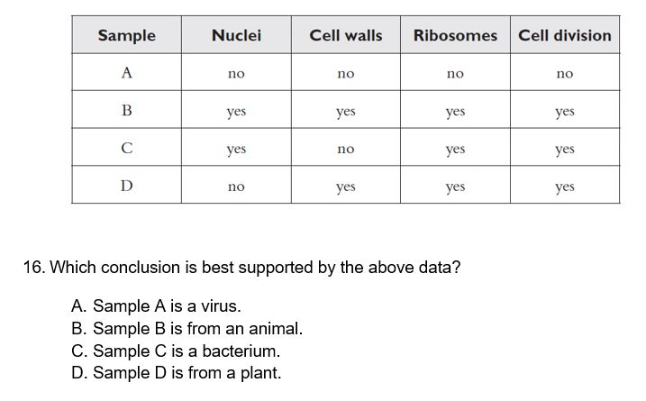

Slide 7
People infected with HIV (human immunodeficiency virus) have an increased risk of dying from secondary infections. Which of these best explains how HIV increase the danger of secondary infections?
  HIV produces antigens that damage red blood cells
  HIV adds genetic material from harmful pathogens
  HIV destroys helper T-cells
  HIV consumes nutrients like a parasite

Slide 8
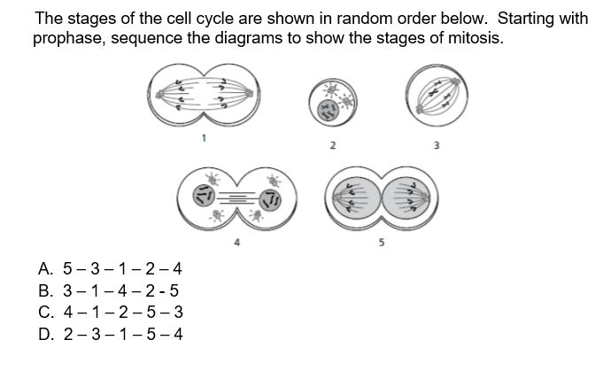

Slide 9
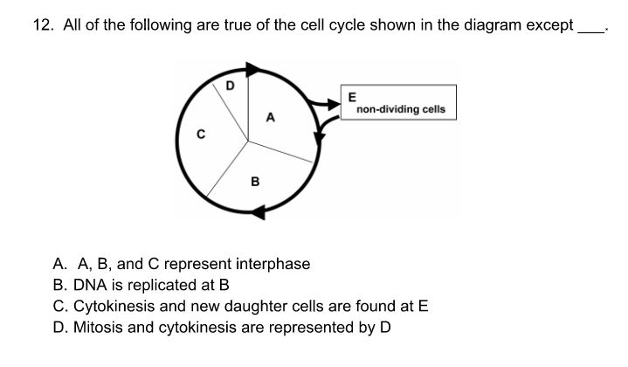

Slide 10
All of the following are true about DNA replication except ___.
  It is semiconservative
  It occurs during the S-phase of the cell cycle
  It allows daughter cells to have exact copies of the genetic code
  It reduces the chromosome number by half for the production of gametes

Slide 11
The figures below show four processes involving DNA and RNA. Use these figures to answer the next question. Which figure shows the process of replication?
  Figure 1
  Figure 2
  Figure 3
  Figure 4

Slide 12
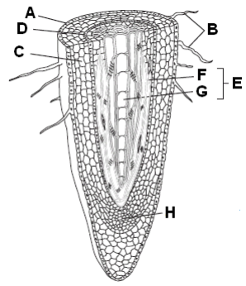
The specialized cells in which structure absorb water from the soil by osmosis?
A. Letter A
B. Letter B
  Letter C
  Letter H

Slide 13
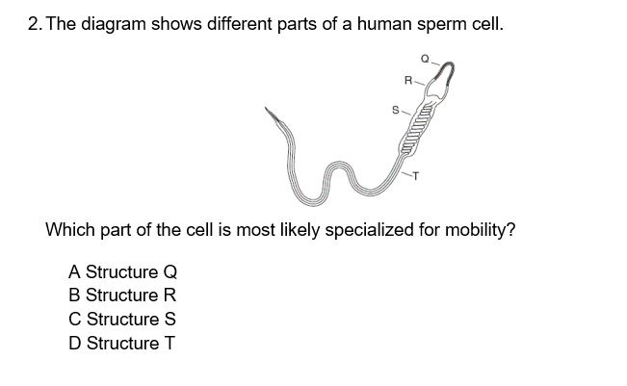

Slide 14
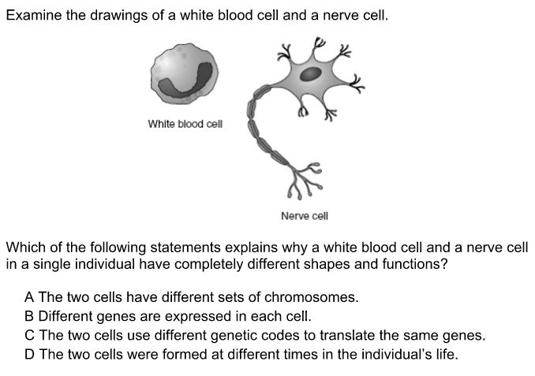

Slide 15
Each cell within a developing body will express different genes, depending on the cell’s age and the location within the body. How is gene expression regulated?
  By internal and environmental cues
  By messenger RNA
  By temperature an light exposure
  By mutations caused by imperfect gene replication

Slide 16
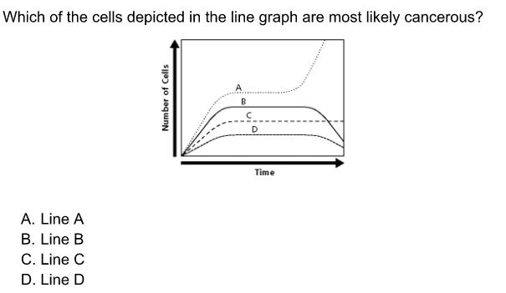

Slide 17
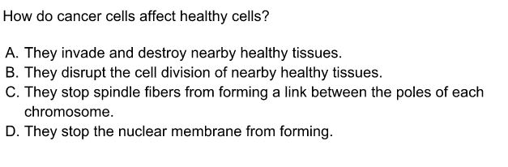

Slide 18
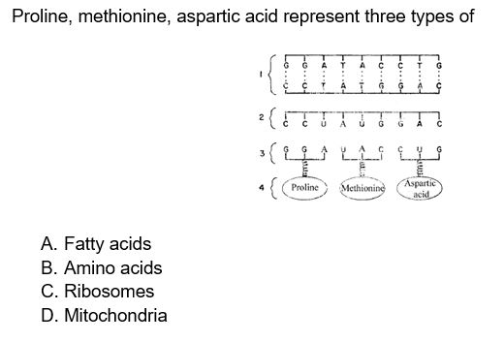

Slide 19
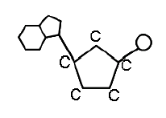
  The diagram below is the monomer of nucleic acids. What is this monomer? a. amino acid b. saccharide c. 3 fatty acids & glycerol d. nucleotide

Slide 20
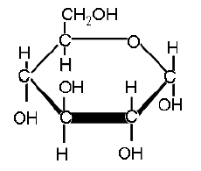
  The diagram below represents which of the following biomolecules? a. carbohydrate b. protein c. lipid d. nucleic acid

Slide 21
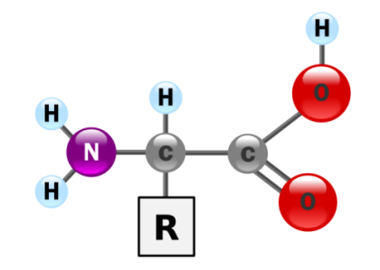
  The diagram below represents which of the following biomolecules?
  a. carbohydrate
  b. protein
  c. lipid
  d. nucleic acid

Slide 22
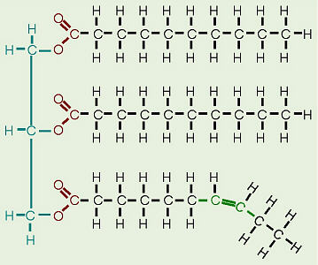
  The diagram below represents which of the following biomolecules? a. carbohydrate b. protein c. lipid d. nucleic acid

Slide 23
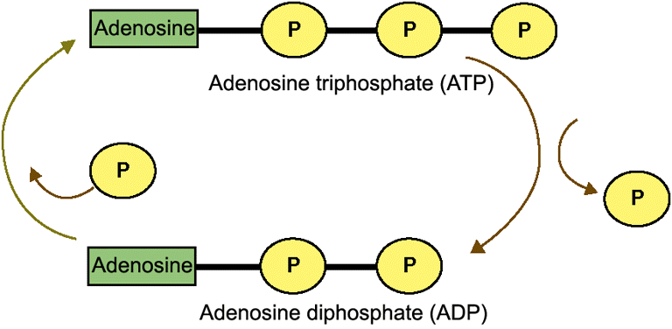
Study the diagram below which illustrates the cyclic nature of the formation and breakdown of the molecule adenosine triphosphate (ATP). What happens when the chemical bond, which attaches the third phosphate group to the molecule is broken?
    a. No energy is made available to the cell for cellular functions.
    b. A molecule of adenosine monophosphate (AMP), with one phosphate group, is formed.
    c. Energy is released, which can be used by the cell.
    d. Energy is lost in the process.

Slide 24
Which molecules store and transmit genetic information?
  Lipids
  Proteins
  Nucleic Acids
  Carbohydrates

Slide 25
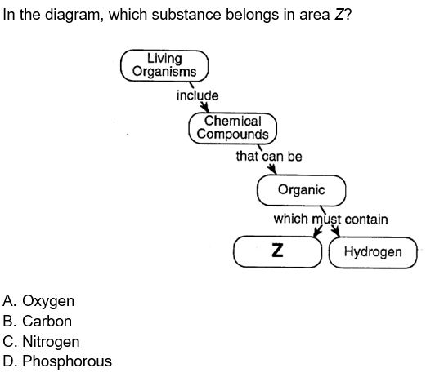

Slide 26
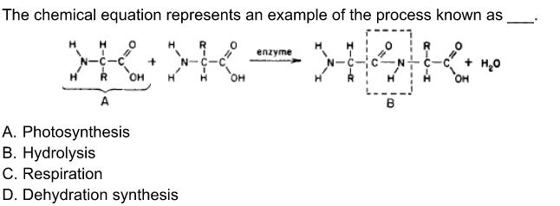

Slide 27
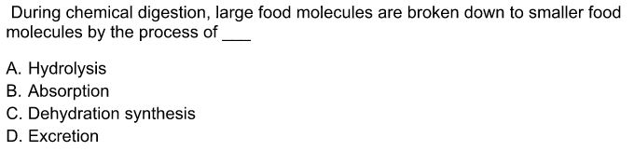

Slide 28
Which of the following statements about enzymes is true?
  a. Amylase, a digestive enzyme found in saliva, helps break down food molecules.
  b. Enzymes do not play a role in metabolic processes of the body.
  c. Enzymes are chemically altered during reactions in which they are involved.
  d. Enzymes always slow the rate at which a chemical reaction occurs.

Slide 29
