Slide 1
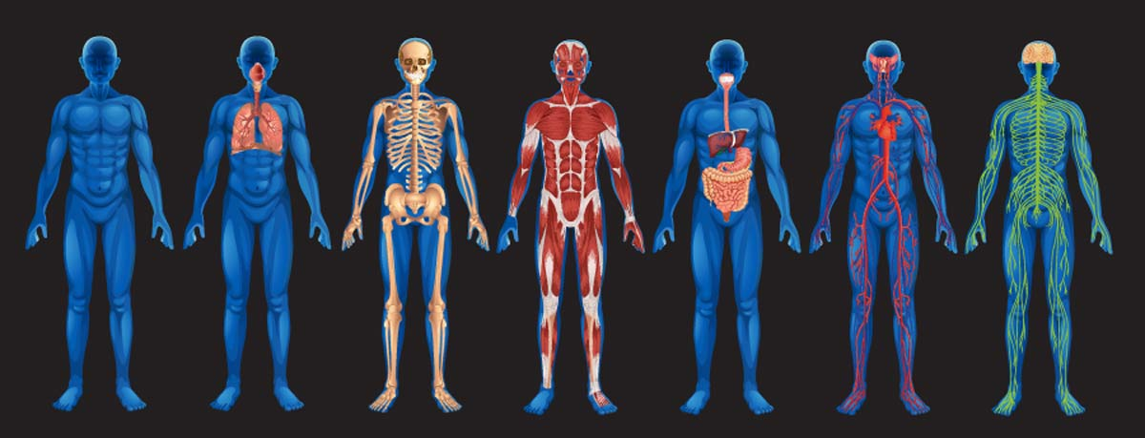
animal Systems

Slide 2
Humans are collections of specialized cells
Specialized cells arise from a single cell, the zygote (joining of sperm and egg).
The zygote divides and differentiates into more than 200 different type of human cells.
Cell specialization involves 2 steps:
Determination
Differentiation
The cells produced during the first few divisions of the zygote are known as stem cells.
Within a few weeks, determination occurs and most stem cells become committed to develop into only one type of cell.
Cell differentiation is the process by which the committed cells acquire the structures and functions of highly specialized cells.
This occurs because specific genes in each cell are turned on and off in a complex, regulated pattern.

Slide 3
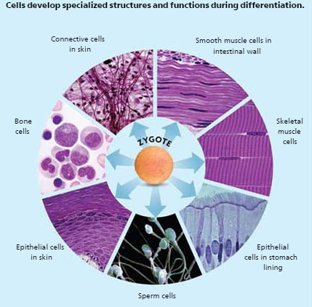
Cell
Specialization

Slide 4
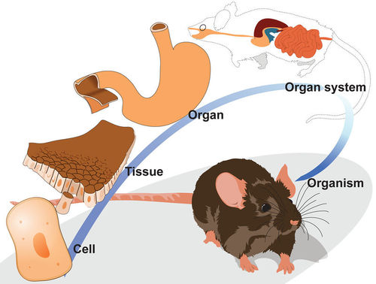
Levels of Organization

Slide 5
Levels of Organization
Cells- the smallest unit of life and the first level of organization in multicellular organisms.
Tissue– A group of similar cells that work together to perform a specialized function
There are 4 basic types of tissue:
Epithelial tissue – glands and tissues that cover interior and exterior body surfaces (ex: skin & membranes that line organs)
Connective tissue– provides support for the body and connects its parts (ex: tendons, ligaments, bone, cartilage)
Nervous tissue– transmits nerve impulses (ex: nerve cells, brain cells)
Muscular tissue – enables the body to move (ex: heart, bicep)
Organs- group of tissues that carry out a specialized function of the body
Organ system- two or more organs that work together to perform body functions

Slide 6
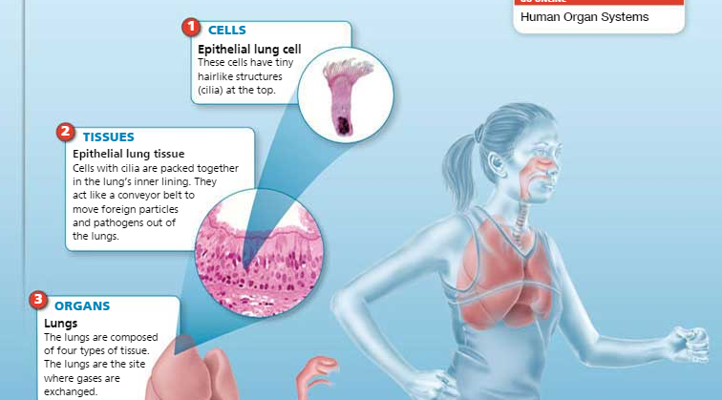
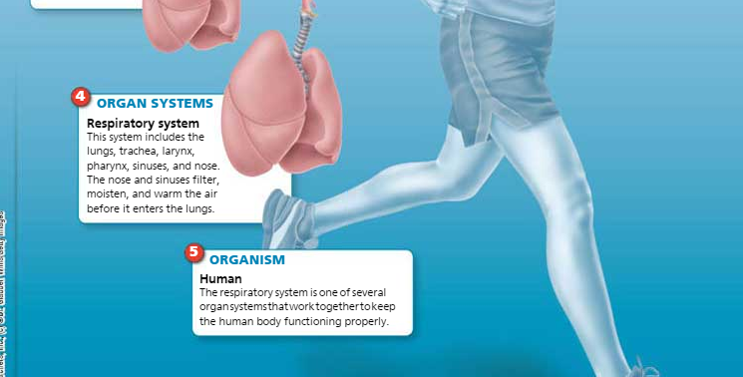

Slide 7
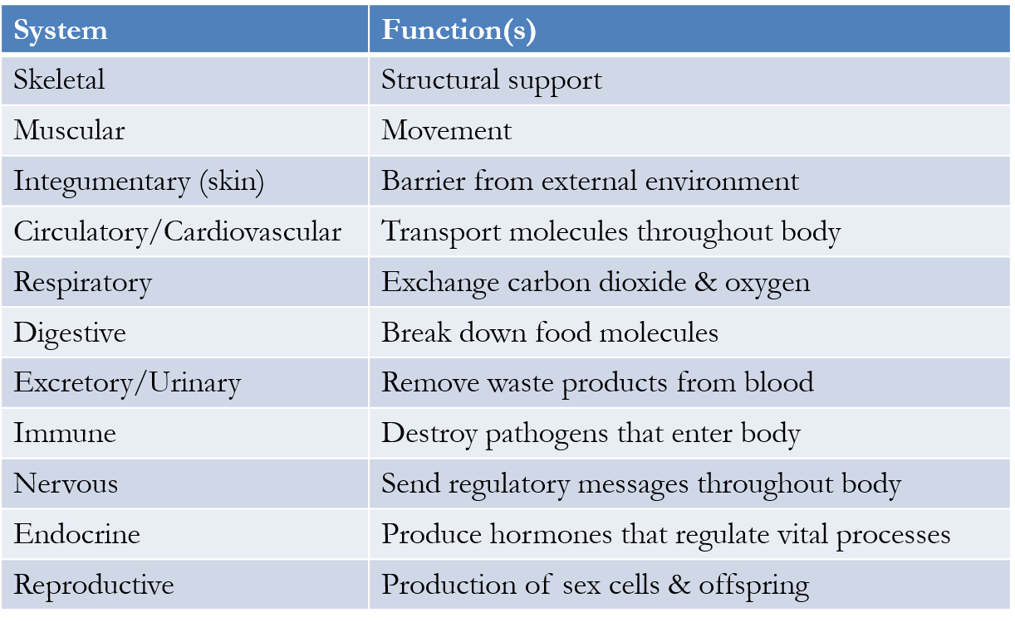
Eleven major organ systems:

Slide 8
Skeletal System: Functions
Supports the body
Protects internal organs
Works with the muscular system to enable mobility
Forms blood cells

Slide 9
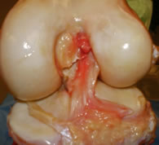
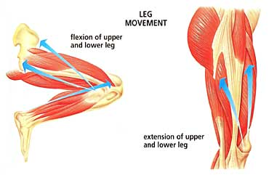
The Skeletal System
The bones of the body make up the skeletal system (206 bones in adults)
FUNCTION: Bones provide protection for internal organs and work with muscles to enable movement
Similar to the function of tree trunks- hold us up right
The place where two bones meet are called joints
A tough connective tissue called cartilage cushions the bones at the joints
Bands of connective tissue called ligaments hold bones together
Bone: soft tissue (produces red blood cells, white blood cells and platelets) and hard tissue
anterior cruciate
ligament

Slide 10
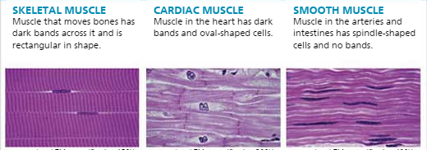
Muscular System
Body system that moves bones at joints and pushes substances such as blood, food, and fluids throughout the body.
Your body has over 600 muscles.
All muscles are specialized for contraction.
Types of muscles:
Smooth muscle – found in organs and blood vessels. Under involuntary control
Cardiac muscle – found only in the heart. Under involuntary control
Skeletal muscle – attached to bones by strips of connective tissue called tendons, controlled by central nervous system, lots of mitochondria (for energy usage). Under voluntary movement.

Slide 11
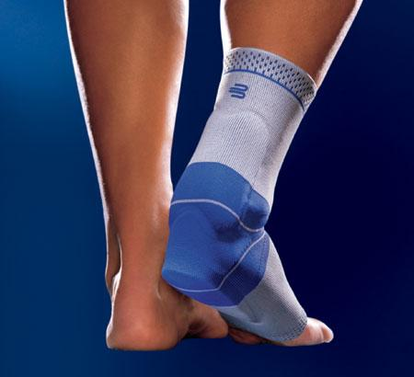
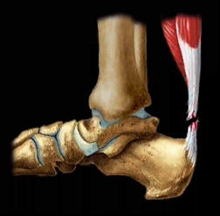
How muscles work…
Muscles receive a nerve impulse which causes them to contract.
They are attached to bones in opposing pairs
Flexor muscles cause a joint to bend
Extensor muscles cause a joint to straighten
Connective tissues called tendons connect the muscles to the bones

Slide 12
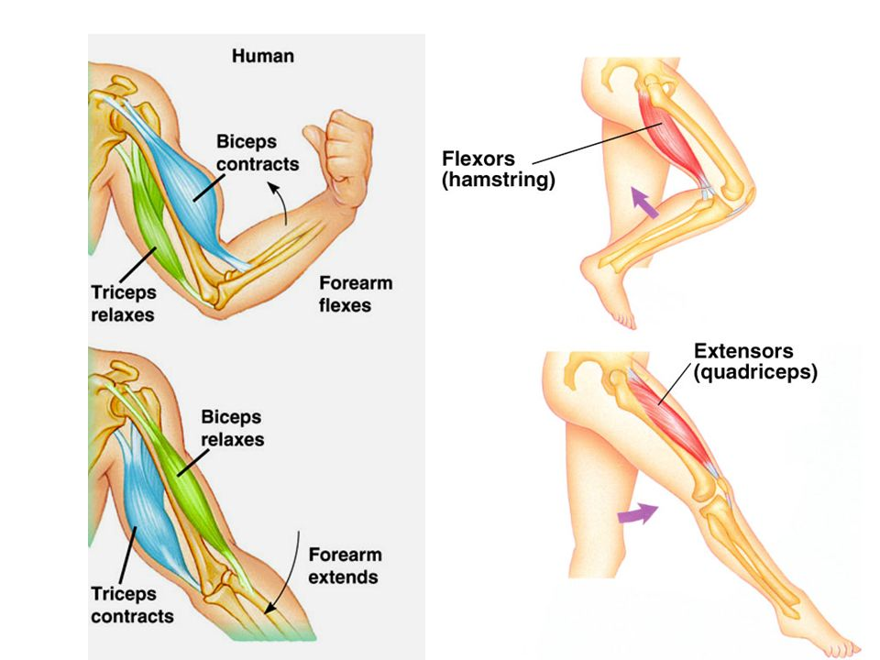
Flexor Muscle
Extensor Muscle

Slide 13
The Respiratory System
Function: responsible for the exchange of oxygen and carbon dioxide between blood, air and tissues
Oxygen is brought into the body and carbon dioxide is expelled.
Consists of the nose and mouth, trachea, lungs (bronchi and alveoli).

Slide 14
Respiratory system

Slide 15
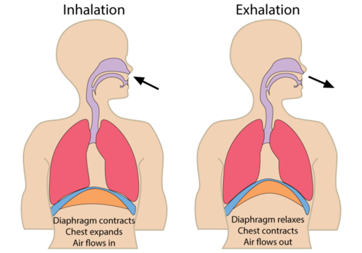
The diaphragm
The diaphragm is the strong muscle that divides our chest and abdominal cavities and causes our lungs to expand.

Slide 16
The purpose of the respiratory system is to bring in oxygen and to release wastes…especially carbon dioxide.
Without it our cells wouldn‘t get the oxygen they need to burn carbohydrates for energy.
When you need more energy you breathe harder and faster to bring in more oxygen!
Why?
For cellular respiration & to get energy in the form of ATP!

Slide 17
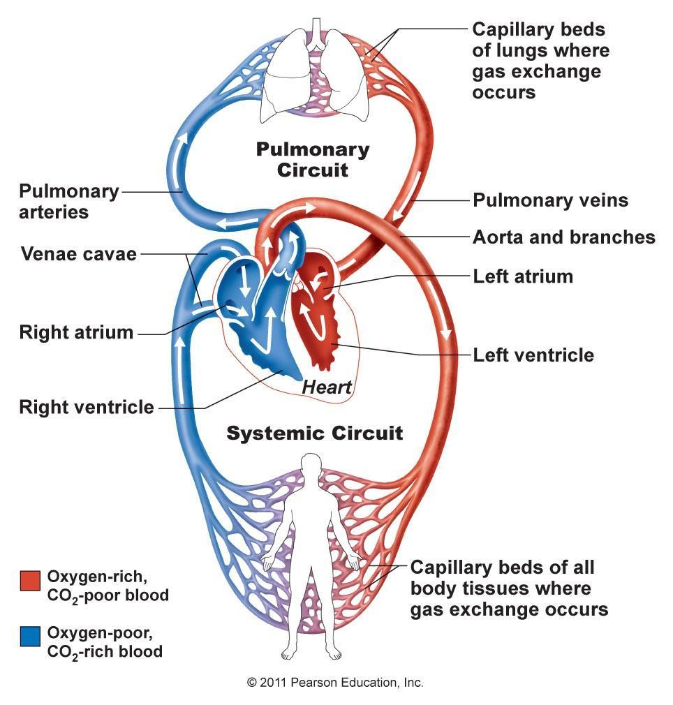
The Circulatory System
Consists of the heart (pump), arteries, veins, and capillaries (blood vessels).
Humans have a double looping circulatory system.
That means one loop carries oxygenated blood to the body & the other loop carries deoxygenated blood to the lungs to get oxygenated after the oxygen has been used.

Slide 18
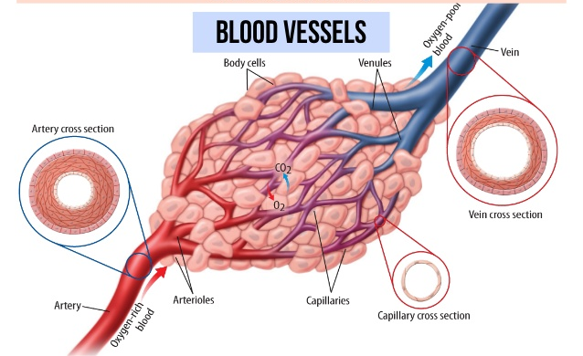
The purpose of the circulatory system is to
move the blood around the body
collect waste materials produced by digestion and cell metabolism, delivers it to the kidneys to be filtered out of the body
distribute heat produced in muscles and internal organs

Slide 19
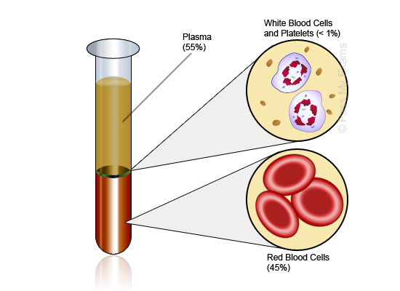
The blood
Plasma- makes up 55% of blood. Helps maintain blood pressure and body temperature
Red blood cells – carry oxygen to the cells due to hemoglobin (an oxygen binding molecule) in their cytoplasm
White blood cells – various types of white blood cells aid in fighting pathogens (they are part of our immune system)
Platelets/Thrombocytes – aid in blood clotting (produced in bone marrow)

Slide 20
Relationships
The trunk of a tree carries out functions that are similar to the functions performed by the skeletal and circulatory systems in the human body!
At higher altitudes, the air organisms breathe is thinner, therefore there is less oxygen moving throughout their bodies.
At higher altitudes organisms produce more red blood cells to carry oxygen quickly throughout their body.

Slide 21
The Reproductive System
What is the purpose of sexual reproduction?
Genetic variation
Why do we undergo meiosis?
To reduce the number of chromosomes by half
So that both parents are able to contribute part of the genetic material
Gametes
Gametes are the sex cells that are formed during meiosis…female and male gametes both are haploid (they only contain half the number of chromosomes that a “normal” cell contains
Females produce eggs
Males produce sperm
When a male gamete and a female gamete combine a zygote (fertilized cell) is formed

Slide 23
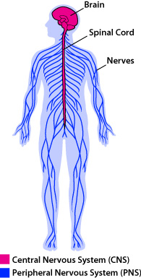
The Nervous System
Our nervous system is how all of the parts of our body communicate with all of the other parts. This is why we aren’t a bunch of separate parts doing their own thing!

Slide 24
Neurons
The cells in the nervous system are called neurons
Neurons contain a cell body with a nucleus
They also have dendrites (dozens) that receive signals either from other neurons or from the environment
They have an axon (one) as well that sends the signal on to the next neuron (away from the cell body)
A bundle of axons make up nerves
Nerve impulses travel really quickly (250 miles per hour…400 km per hour)
When they get to the end of an axon they must cross the synapse…the gap between the neurons
They do this by causing chemicals (neurotransmitters) to be released that cross and create a new impulse at the other side

Slide 25
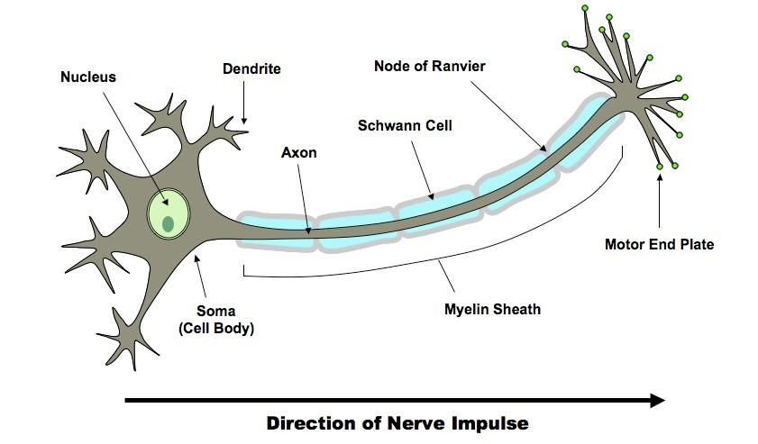

Slide 26
Structures of the nervous system
Neurons are the smallest parts of the nervous system but they come together to form two parts
The Central Nervous System (CNS)
The brain (cerebrum, cerebellum, medulla, and hypothalamus) and spinal cord (involved in reflex actions)
Relays messages, processes and analyzes information
The Peripheral Nervous System (PNS)
Receives information from the environment & relays commands from the CNS to glands and organs
Sensory neurons: send information to CNS from sensory organs
Motor neurons: send information from CNS to organs in the body such as muscles
Contains the somatic nervous system- voluntary, conscious control over organs
Contains the autonomic nervous system- Controls involuntary (no conscious control) muscles, such as smooth & cardiac
Sympathetic
Parasympathetic

Slide 27
Autonomic Nervous System
Two parts: Sympathetic & Parasympathetic
Sympathetic: involved in stimulation of activities that prepare the body for action such as:
increasing the heart rate
Increasing the release of sugar from the liver into the blood
Fight or flight responses (responses that serve to fight off or retreat from danger)
Parasympathetic: activates tranquil functions such as:
Stimulating the secretion of saliva or digestive enzymes into the stomach
Rest & Digest

Slide 28
Peripheral nervous system

Slide 29
Peripheral Nervous System
Reflex Arc: Interaction between the nervous system and the musculoskeletal system; essential for prevention of injury
A stimulus leads to an immediate action (ex: a light flashed in one eye causes the pupil to constrict)
4 main parts
Sensory receptor
Sensory neuron
Motor neuron
Effector
Example: touching a hot object
Sensory receptor: senses the hot object/stimulus
Sensory neuron: relays message to brain
Motor neuron: transfers the heat signal to the responding muscle
Effector: contracts & causes the hand to pull away
Example: if you step on a tack with your foot, the sensory receptors relay a message to your sensory neuron, which sends a message to your interneurons in the spinal cord that activates the motor neurons to cause your muscles to contract, thereby pulling your foot away from the tack

Slide 30
Reflex arc

Slide 31
endocrine system

Slide 32
The Endocrine System
The endocrine system is another way that your body communicates with itself.
The human endocrine system is made of a series of glands that release hormones into the blood stream.
Hormone – a chemical that is produced in the body to control the functions of systems.
The functions of hormones include:
Regulating growth, development, behavior, and reproduction
Coordinating the production, use, and storage of energy
Maintaining homeostasis (temperature, salt balance, metabolism, excretion)
Responding to stimuli from outside the body
Glands – organs that produce and secrete hormones

Slide 33
Fight or Flight
Response mechanism designed to prepare a person for immediate action against a perceived threat
They can either fight or flee.
Endocrine system releases hormones which the circulatory system carries to muscles which respond.

Slide 34
Endocrine Glands
Hormones are produced in the endocrine glands
These glands secrete hormones directly into the blood or the fluid around the cells
The endocrine glands can act independently or together to help maintain homeostasis
The pituitary gland is the “master gland”
It secretes hormones that regulate all of your other glands.
Hypothalamus produces releasing hormones that tell the pituitary gland (master gland) to release hormones such as growth hormone or antidiuretic hormone (ADH) which causes kidneys to retain water

Slide 35
Hormones

Slide 36
Glands | Hormones | Function
Adrenal glands | aldosterone cortisol | Maintains salt-and-water balance Regulates carbohydrates and protein metabolism
Adrenal glands | epinephrine norepinephrine | “fight or flight” response
Ovaries | estrogen progesterone | Regulates female characteristics and Maintains growth of uterine lining
Pancreas | Glucagon Insulin | Stimulates the release of glucose (not enough glucose) Stimulates the absorption of glucose (if you have too much)
Testes | Androgens (testosterone) | Regulates male characteristics

Slide 37
The Digestive System
The food you eat contains nutrients, fats, proteins, carbohydrates, vitamins and minerals
Most of these molecules are too big to pass through the cell membrane…
That’s where the digestive system comes in…
The process of breaking food molecules into smaller molecules is called digestion.
Function: convert foods into simpler molecules that can be absorbed and used by the cells of the body

Slide 38
Digestion
Digestion starts out with mechanical digestion in the mouth
Some chemical digestion
Saliva contains amylases (enzymes) that break down carbohydrates/substances to be absorbed & used as energy for growth, repair and movement
When you swallow, food passes into the esophagus & is moved along by wavelike contractions called peristalsis
Food then moves into the stomach where acids break down proteins and the food continues to get mixed and mechanically broken down
Food passes from the stomach into the small intestine (chemical digestion)
Secretions from the pancreas, liver, and gall bladder enter the small intestine and complete the digestion of fats, proteins, and carbohydrates
The nutrients from these molecules are absorbed by the lower parts of the small intestine… Food is no longer being broken down!

Slide 39
Digestion examples
Amylase → break down of starch in saliva
Pepsin → break down of proteins in the stomach
Lipase → lipids in the small intestine
Amylase → starch in small intestine
Maltase → maltose, sucrase → sucrose, and lactase → lactose: all in the small intestine

Slide 40
The excretory system
Any organ that excretes wastes is part of the excretory system
Ex: skin (integumentary), lungs, large intestines
Functions:
remove waste products from blood
maintain blood pH
regulate water content in blood and blood volume
However, for our purposes, we will focus most of our discussion on the elimination of urine

Slide 41
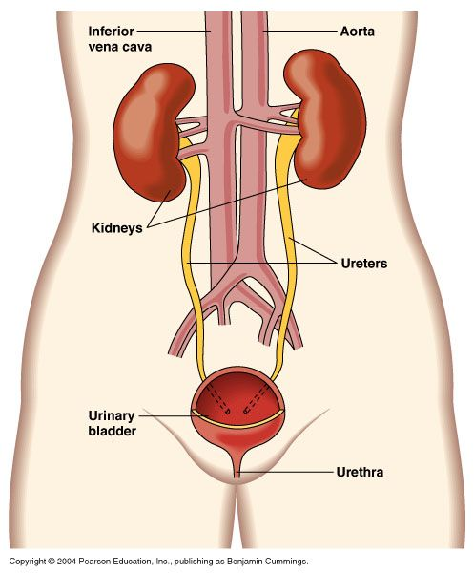
excretory system
Function:
Excretes waste

Slide 42
The urinary system
Kidneys Functions:
Filter water soluble wastes from the blood and they eliminate excess water from the body
Reabsorb water so that we don’t lose too much
The urine produced then passes into the ureters, which are the tubes that lead to the bladder
The bladder holds the urine
The urine then exits the body through the urethra

Slide 43
Feedback/Homeostasis
Predict what you think would happen when you become dehydrated. (Think about kidneys, blood & urine)
To compensate for lack of water, your kidneys remove less fluid from your blood and produce less urine
This is called retaining fluids- this happens when you are thirsty or dehydrated

Slide 44
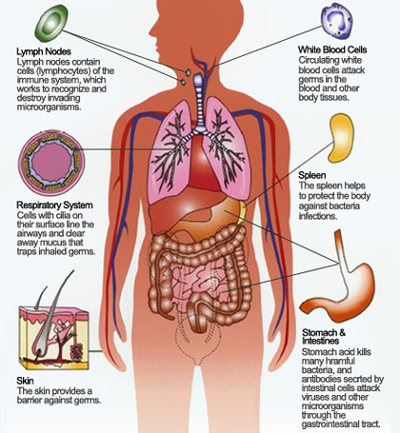
The immune system
How we protect our bodies….

Slide 45
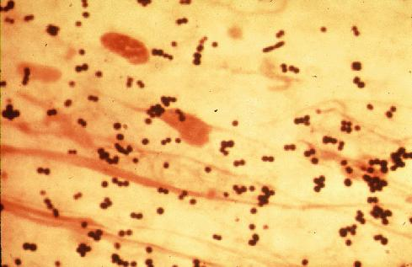
Pathogens
Microscopic organisms are everywhere
Luckily MOST are not harmful
Disease causing microorganisms are called pathogens
How does our body protect itself from pathogens?
The immune system
Nonspecific defenses
Immune (specific) response

Slide 46
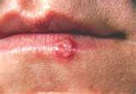
Nonspecific defenses
With nonspecific defenses the body does NOT target particular pathogens
The first lines of defense are your SKIN and mucous membranes!
If a wound occurs, an inflammatory response may occur and an increase in temperature (area becomes more warm)
Histamines cause blood vessels to dilate (swelling can occur)
Blood flow to the area increase so white blood cells can attack pathogens
The body temperature rises…most pathogens only grow in a particular temperature range (close to NORMAL body temperature)

Slide 47
Specific Immune Response/ White blood cells
If pathogens pass the non-specific line of defense, specific defenses are employed to attack a specific pathogen– these are called the immune response
Pathogens carry antigens (like a nametag) which the body recognizes as an invader The cells that recognize specific antigens are B lymphocytes (B cells) and T lymphocytes (T cells)
B cells: produce antibodies (proteins that recognize and bind to antigens)
once body has been exposed to the pathogen, memory B cells are capable of producing antibodies specific to that pathogen
This is how vaccines work!
T cells: different types such as cytotoxic T cells or killer T cells, helper T cells, memory T cells
Killer T cells destroy bacteria, fungi, protozoan or foreign tissue

Slide 48
Acquired immunity
Acquired Immunity is produced/acquired by infection or vaccination or by the transfer of antibody or lymphocytes from an immune donor
The type of immunity produced by the body’s reaction to a vaccine is known as active immunity
This occurs after exposure to an antigen, as a result of the immune response or natural exposure to an antigen (fighting an infection) that produces antibodies
If antibodies from another organism are injected into the bloodstream, this produces passive immunity against the pathogen
This type of immunity is temporary due to the destruction of foreign antibodies, and can develop naturally (breast-fed babies) or deliberately (vaccine with antibodies)

Slide 49
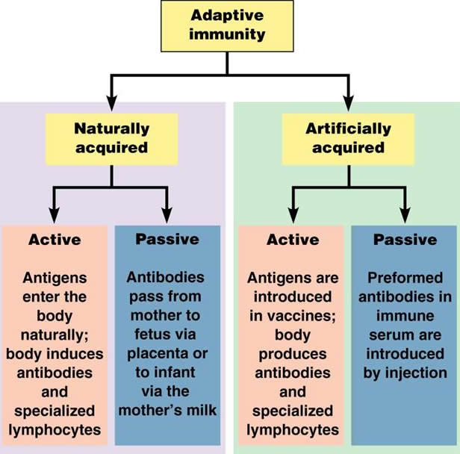

Slide 50
Autoimmune disease
Autoimmune disease is when the immune system makes a mistake and attacks the body’s own cells
Ex: Type I diabetes, rheumatoid arthritis, and multiple sclerosis (MS)
Type I diabetes- antibodies attack the insulin-producing cells of the pancreas
Rheumatoid arthritis- antibodies attack the connective tissue around the joints
Long-term disease that leads to inflammation of the joints and surrounding tissues
MS- antibodies destroy the functions of the neurons in the brain and spinal cord
Medications can be used to treat symptoms (ex: insulin injections for Type I diabetes) or suppress the immune system

Slide 51
Allergies
Allergies are overreactions of the immune system to antigens
Ex: allergens (antigens that cause allergic reactions) include dust, mold, bee stings, pollen
When allergy-causing antigens (allergens) enter the body, they attach themselves to mast cells (specialized immune cells that initiate the inflammatory response)
The activated mast cells release histamine which increases blood flow and fluids to the surrounding area
The result is also increased mucus production in the respiratory system– this stimulates sneezing, watery eyes, runny nose and irritation
Medications include antihistamines that counter the effects of the histamines

Slide 52
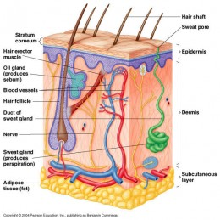
Integumentary system
The skin is your largest organ
The skin along with your hair and nails make up the integumentary system

Slide 53
Integumentary System
Functions:
protection- barrier against injury, infection, and radiation
regulate body temperature
remove waste products (acts as organ of excretion/detoxification)
Contains: sensory receptors for pressure, heat, cold and pain
How it regulates body temp:
When hot:
sweat glands produce sweat which, when evaporated, removes heat from the body
blood vessels dilate (vasodilation) increasing surface area so that heat from core is released
When cold:
blood vessels constrict (vasoconstriction) reducing surface area to conserve heat

Slide 55
SYSTEM | MAJOR TISSUES & ORGANS | PRIMARY FUNCTION
Circulatory | Heart, blood vessels, blood, lymph nodes, lymphatic vessels | Transports oxygen, nutrients, wastes; helps regulate body temperature; collects fluid lost from blood vessels and returns it to the circulatory system
Digestive | Mouth, pharynx, esophagus, stomach, small/large intestines, pancreas, gallbladder, liver | Breaks down and absorbs nutrients, salts and water; eliminates some wastes
Endocrine | Hypothalamus, pituitary, thyroid, parathyroid, adrenal glands, pancreas, ovaries, testes | Influences growth, development, metabolism; helps maintain homeostasis
Excretory | skin, lungs, kidneys, bladder | Eliminates waste products; helps maintain homeostasis
Immune | White blood cells, thymus, spleen | Protects against disease; stores and generates white blood cells
Integumentary | Skin, hairs, nails, sweat and oil glands | Acts as a barrier against infection, injury, UV radiation; helps regulate body temperature
Muscular | Skeletal, smooth and cardiac muscles | Produces voluntary and involuntary movements; helps to circulate blood and move food through the digestive system
Nervous | Brain, spinal cord, peripheral nervous | Regulate body’s response to changes in internal and external environment; processes information
Reproductive | Male: testes, penis, associated ducts and glands Female: ovaries, fallopian tubes, uterus, vagina | Produces reproductive cells; in females, provides environment for embryo
Respiratory | Nose, sinuses, pharynx, larynx, trachea, lungs | Brings in oxygen for cells; expels carbon dioxide and water vapor
Skeletal | Bones, cartilage, ligaments, tendons | Supports and protects vital organs; allows movement; stores minerals; serves as the site for red blood cell production

Slide 56
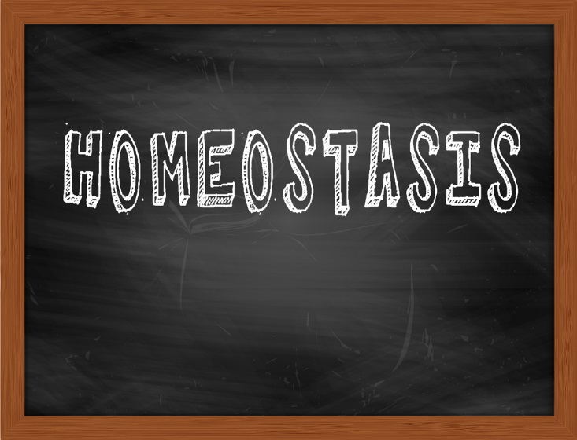

Slide 57
How do organisms regulate their body temperature?

Slide 58
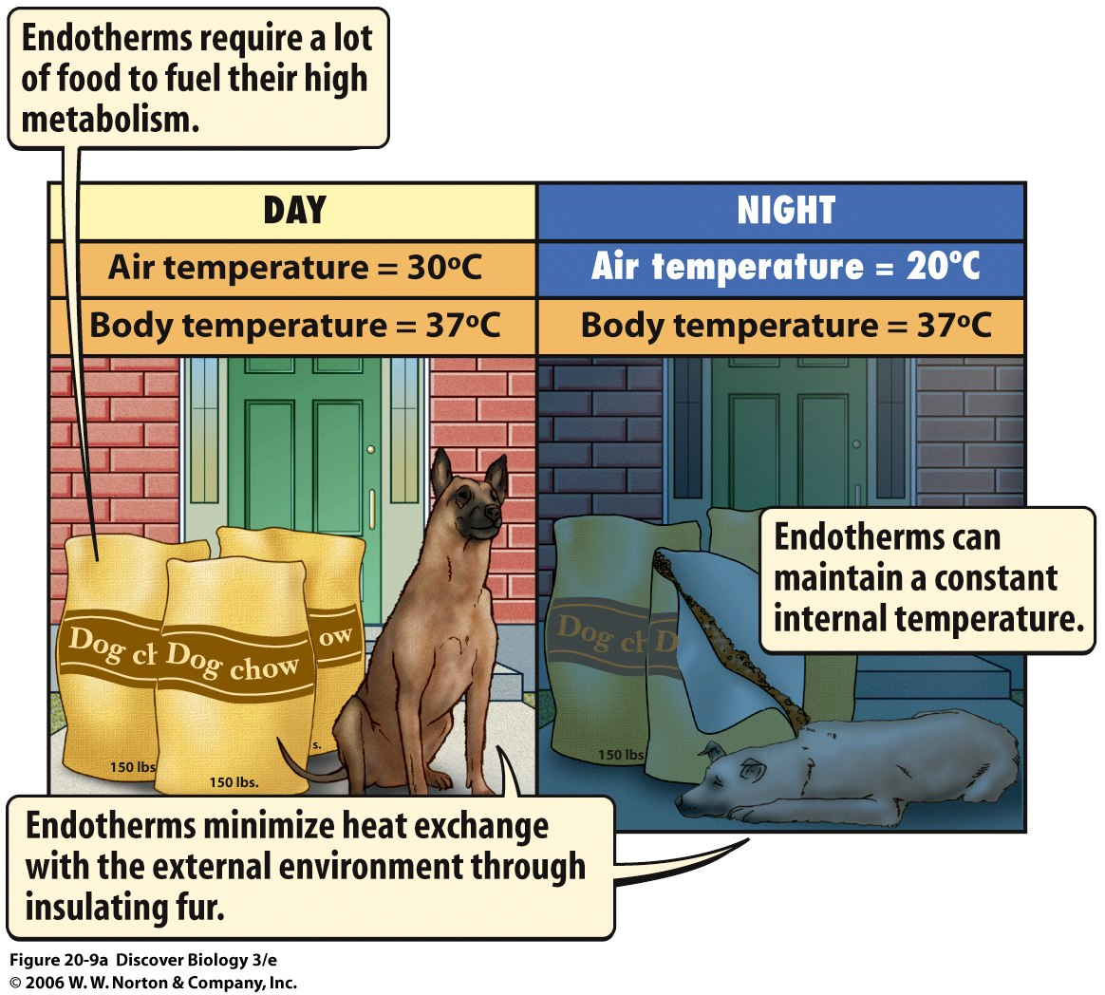
Endotherms

Slide 59
Ectotherms

Slide 60
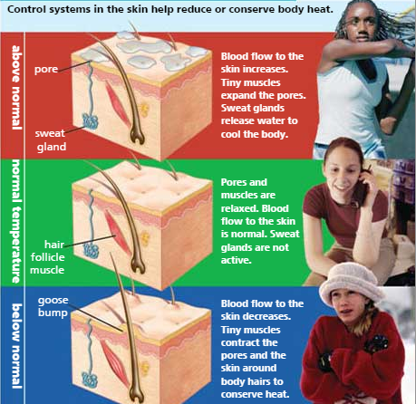
Homeostasis
The eleven organ systems of the human body work together to maintain homeostasis in the body as a whole.
Homeostasis is the regulation and maintenance of the internal environment

Slide 61
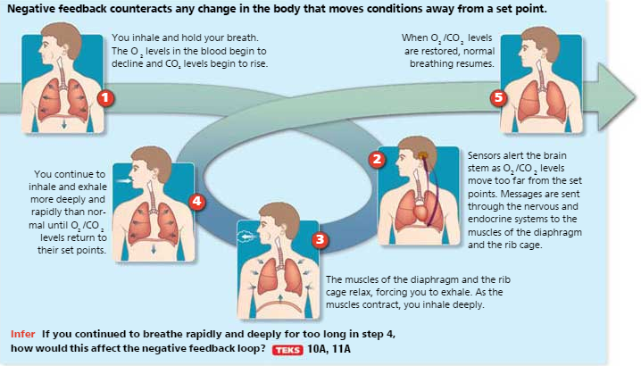
Negative Feedback
negative Feedback

Slide 62
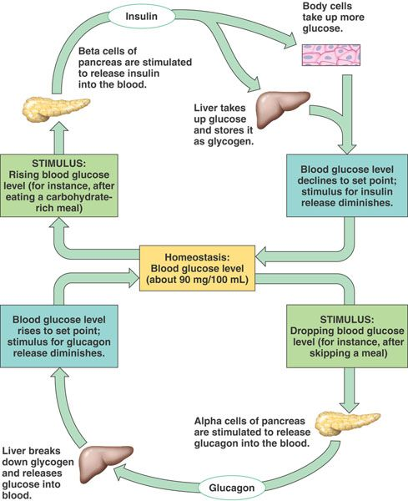
Blood Glucose level Feedback loop

Slide 63
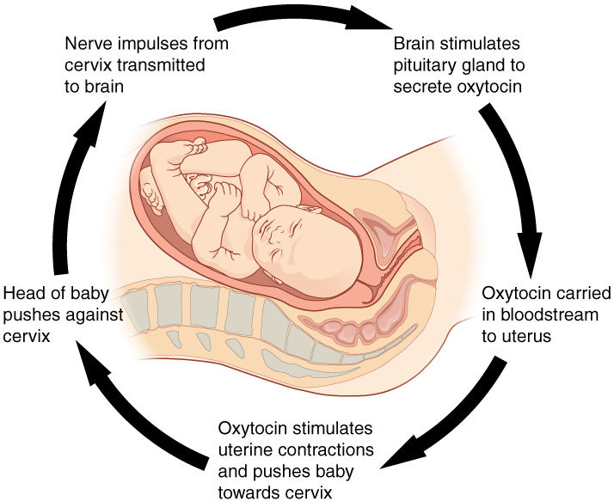
Positive Feedback

Slide 64
Positive feedback loop

Slide 65
Example of positive feedback
Ex. During childbirth, the pressure of the baby’s head against receptors near the opening of the uterus stimulates uterine contractions
When the contractions begin, the hypothalamus releases more of the hormone oxytocin, which in turn causes more contractions
Amplifying contractions= Increased response

Slide 66
How do systems work together to maintain homeostasis?
Thermoregulation is the process by which the body regulates its internal temperature
The organ systems involved in maintaining body temperature are the following:
Integumentary (skin)
Muscular
Respiratory
Circulatory
Nervous
Endocrine
How do all these systems work together?
When temperature of blood falls too low, the hypothalamus (brain) sends a set of signals to the skin, respiratory, circulatory and muscular systems to instruct the blood vessels to constrict, which reduces their size.
Skeletal muscles contract rapidly, causing shivering.
Hormones are released that increase metabolism.

Slide 67
Disruption of Homeostasis- Harmful
Homeostasis can be disrupted for several reasons:
Sensors fail to detect changes in the internal or external environment
Wrong messages may be sent or the correct ones fail to reach their targets
Serious injuries can overwhelm the homeostatic mechanisms
Viruses or bacteria can change the body’s internal chemistry
Disruptions can begin in one organ or organ system and result in a chain reaction that affects other organs and organ systems
Effects can be short term or long term

Slide 68
Short term effects of disruption
Can last a few days or weeks
Ex: cold virus enters body, immune system may not be able to prevent the virus from multiplying
As a result you develop a sore throat, runny nose, and dry cough, and your muscles and joints become inflamed
Within a few days, your body’s immune system begins to kill the virus and to restore homeostasis– usually no lasting harm is done to the body

Slide 69
Disruption of Homeostasis- Harmful
Homeostasis can be disrupted for several reasons:
Sensors fail to detect changes in the internal or external environment
Wrong messages may be sent or the correct ones fail to reach their targets
Serious injuries can overwhelm the homeostatic mechanisms
Viruses or bacteria can change the body’s internal chemistry
Disruptions can begin in one organ or organ system and result in a chain reaction that affects other organs and organ systems
Effects can be short term or long term

Slide 70
Long term effects of disruption
Can cause more damage than short term effects
Ex: diabetes- occurs when the body fails to control the amount of glucose circulating in the blood, liver and muscle cells
Glucose levels are controlled by 2 hormones- insulin and glucagon- which are released by the pancreas
When glucose in blood rises ABOVE a set point, beta cells in the pancreas release insulin (causes cells to take in more glucose from blood and causes liver to store glucose as glycogen)
When glucose falls BELOW a set point, alpha cells in the pancreas release glucagon which stimulates the liver to break down stored glycogen into glucose and release it until levels in the blood rise to the set point
This is an example of gene regulation being modified by the environment!
If the pancreas fails to do its job: result is diabetes mellitus, a condition in which the body can no longer regulate glucose levels
Type 1 Diabetes- when the body’s immune system destroys the ability of beta cells to produce insulin
Type 2 Diabetes- insulin production decreases or when insulin cannot move glucose into cells

Slide 71
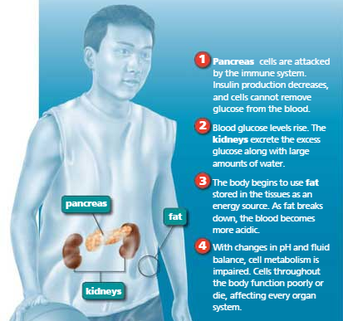
Type 1 Diabetes

Slide 72
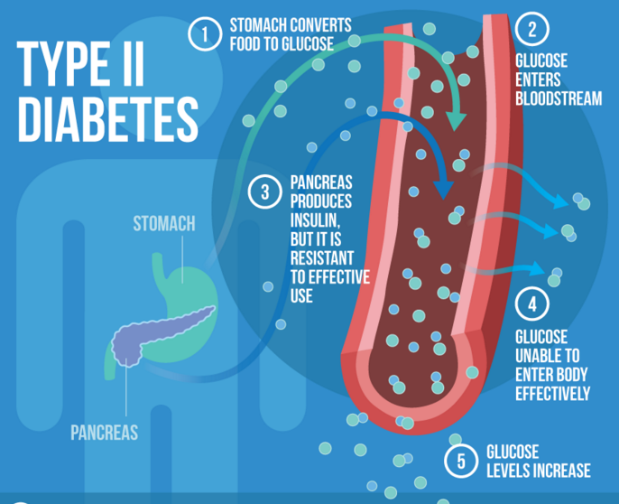

Slide 73
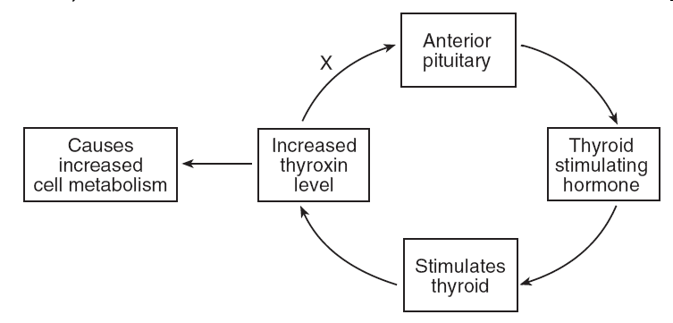
Practice
This diagram illustrates what type of feedback mechanism?
Answer:

